Slide 1

Designing a soldering station Tim Boghe Klas 1EAI - C
1
Notes:
Good afternoon my name is students for the bachelor course elektronics ICT
And im going to take you a tour through my first project the soldering station

Slide 2
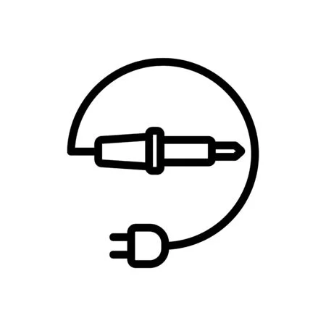
Content presentation
Introduction
Materials and methods
Designs
Conclusion
Questions?
2
Notes:
And on the end of the presentation a moment for questions

Slide 3

Introduction: the choice of the soldering station
Popular tool
Used to repair devices/make own projects
3
Notes:
for proffesionals but also for hobbyists, handymen

Slide 4
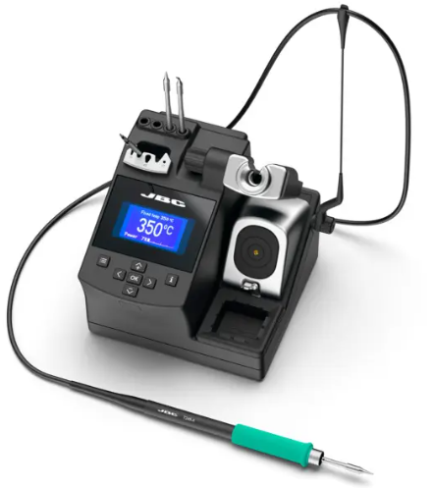
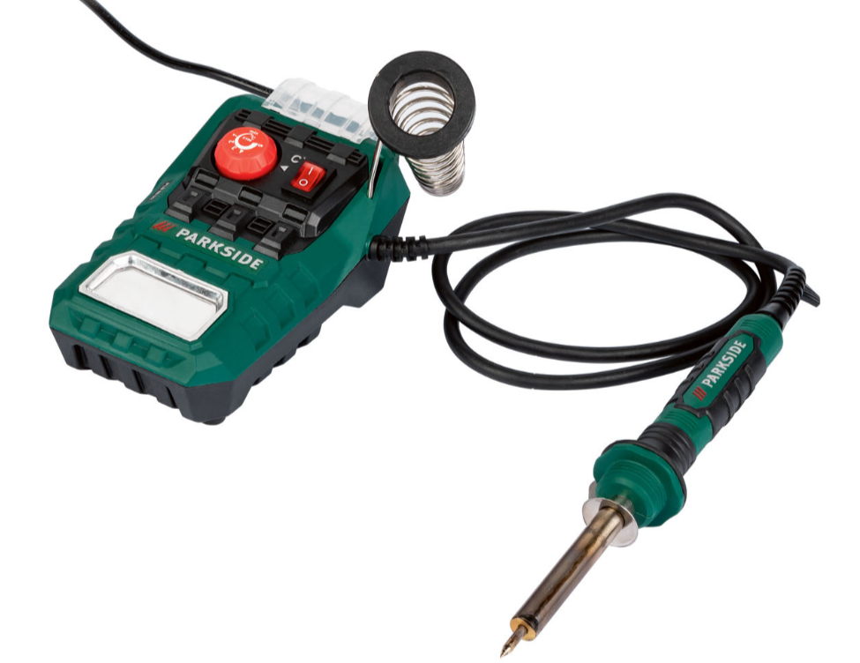
Problems when buying :
Often bad quality for the cheaper models
Price of better devices increases quickly
Dull look
€569,95
For only €17,99
4

Slide 5
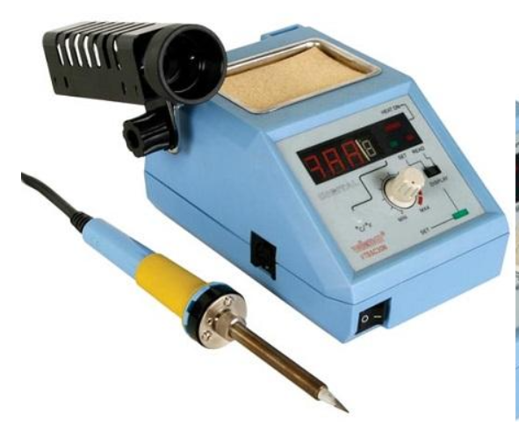
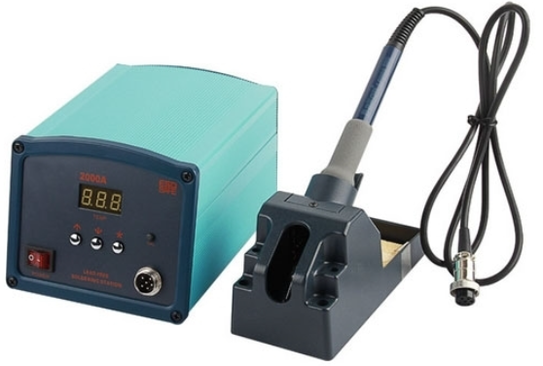
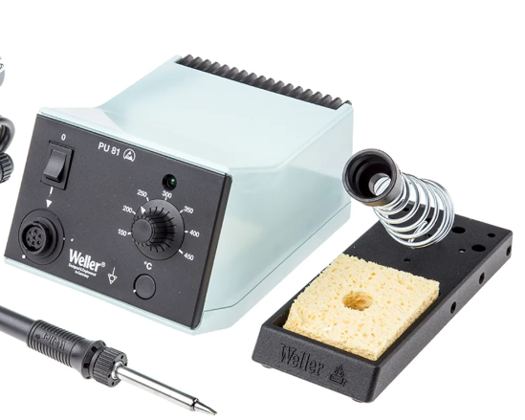
Problem when buying :
Often bad quality for the cheaper models
Price of better devices increases quickly
Dull look
5

Slide 6

Solution = make your own soldering station
6

Slide 7
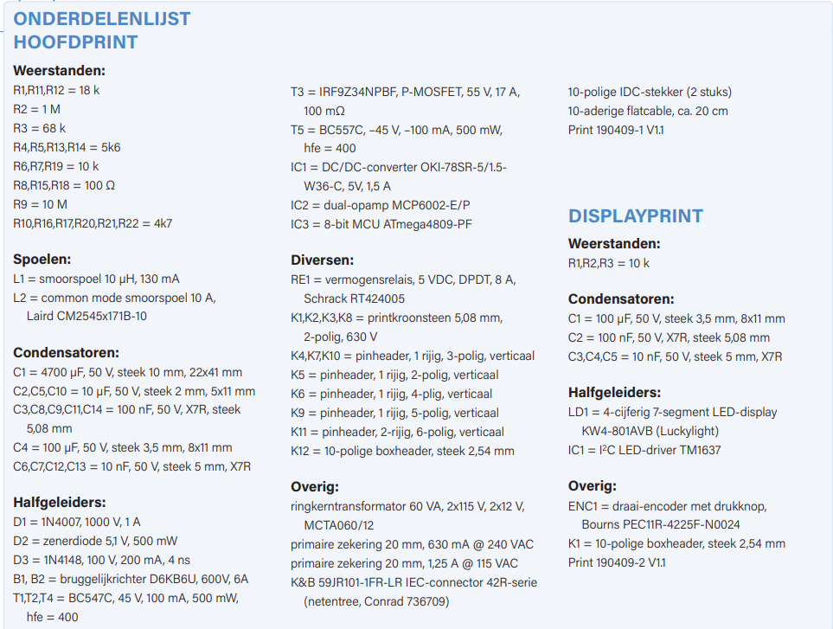
Materials
Mouser = overall used site
Several manufacturers
Easily sorted
Reduce large shipping costs
Other sites (digikey, TME,…)
Based on list Elektor magazine
7
Notes:
1: MOUSER because it was easier and more convient to use one site and order on them (50euro shipping)
Its a wel known and huge site and most components where in stock on that site
There where some exceptions and then we used differende site like TME, digikey
Al the needed components can be found on the list in which is a useful guide for going this for the first time

Slide 8
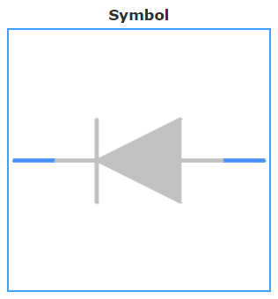
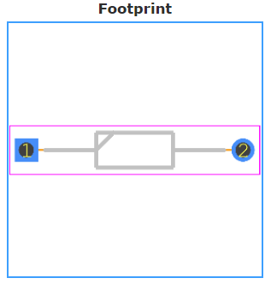
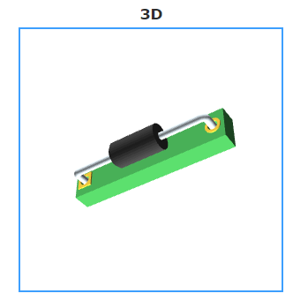
Methods
Step 1
Find suitable components
In Stock?
Step 2
ECAD model download
Upload ECAD model in Altium
Redesign if needed
Step 3
Complete the libraries
Design schematic
8
Notes:
2: MOUSER, easy way to download the ECAD model to get al footprints, shematic symbol en 3d drawing

Slide 9
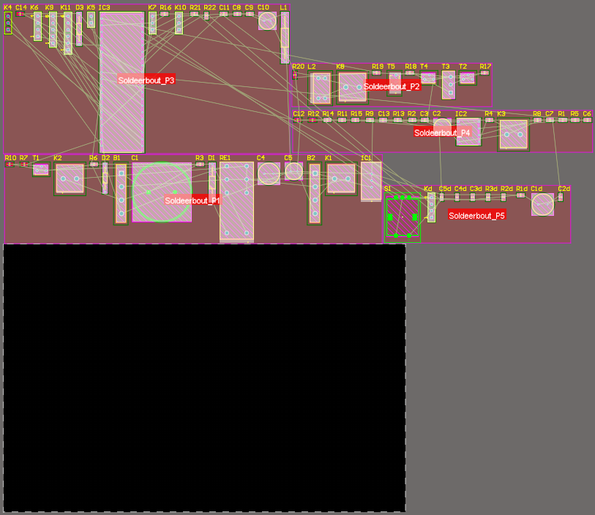
Methods
Step 4
Checking /
correcting errors from the schemetic
Step 5
Create PCB in Altium
Components on PCB
Checking footprints
Step 6
Auto route PCB or do it yourself
Re-adjust routes
Check errors on the PCB
9
Notes:
4: a lot of errors like duplicate names from components, wire without anything attached to them
5: here we the 5 sheets for schematic design are combine through the ports
Here can we decide what the dimensions are from the PCB and what form

Slide 10
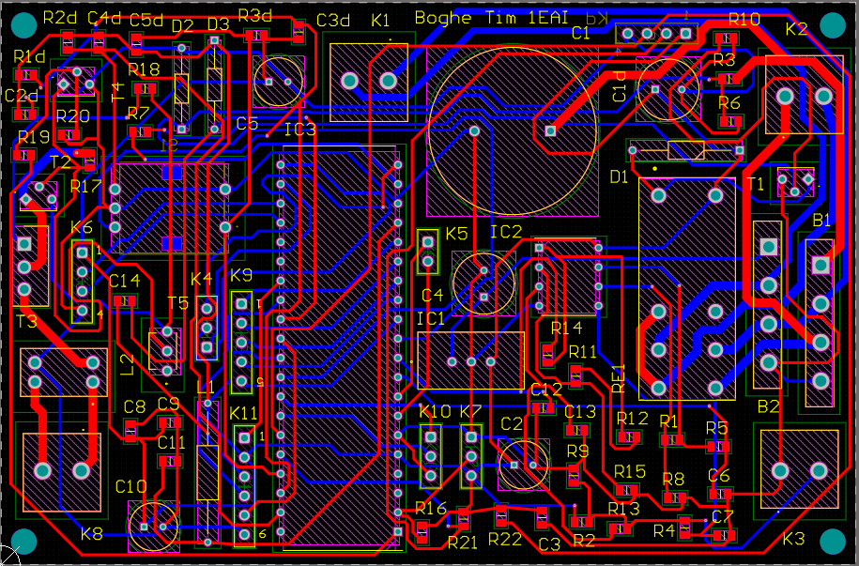
Methods
Step 4
Checking /
correcting errors from the schemetic
Step 5
Create PCB in Altium
Components on PCB
Checking footprints
Step 6
Auto route PCB or do it yourself
Re-adjust routes
Check errors on the PCB
10
Notes:
6: most used on is the auto route the problem is dat sometimes u will get some points u need to correct yourself
Nets that are at a 90° angle (what can be a problem for the flow that is morrored back a bit) thats why its best to make 45° angels in nets
Some nets where strangly placed outside the PCB surface area
The most commond errors where that the nets where to close to the components are the yellow text on pads

Slide 11
Methods
Step 7
Order components
Step 8
Sent the design to JLCPCB
Step 9
Design case for soldering station
Keep room for other components
Step 10
PCB delivered
Place components on PCB
Test PCB
11
Notes:
7: as many did order the components after the PCB was ready (good: if u find a problem in your design with a components not be ideal u can swap it without already paying for the original one)
(Bad: the deadline is push a bit behind, due to waiting for shpiing)
9: other componets tranformer, iec connector, Soldering iron connector (check distance between encodor, connectors and PCB)
10: start with SMD’s due to that the PCB need to put in the oven and cand be done correctie if there are already through hole components on them
(power supply -> testing, other components soldered)

Slide 12
Methods
Step 11
3D print the case
Build PCB + other parts in it
Step 12
Adjust/solve problems in build
Assemble PCB + other components
12
Notes:
Ecad model: download for all components

Slide 13
Designs
Schematic design
PCB design
Physical circuit board
3D design
13

Slide 14
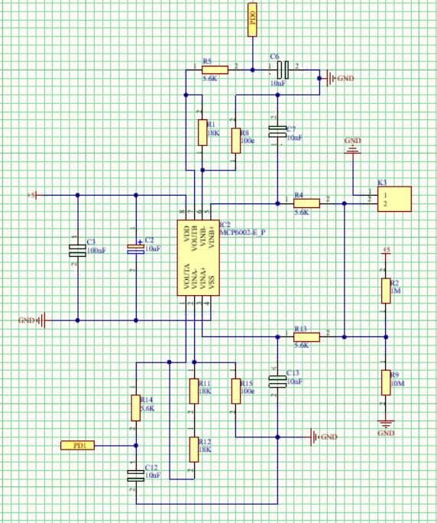
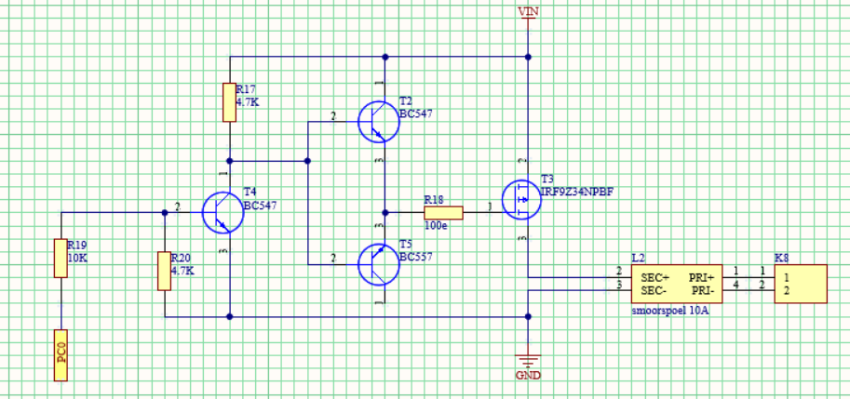
Schematic Designs
14
Notes:
Like a told you in step 5 that i used 5 schemetic sheets that is to keep each part that have a different function separated to keep the overview

Slide 15
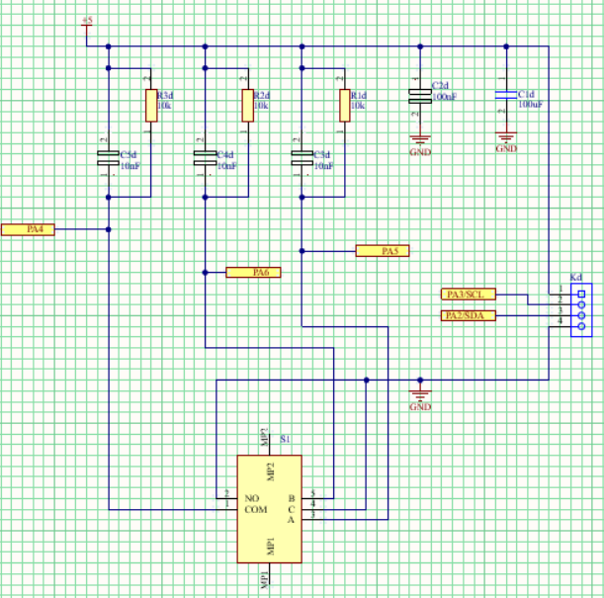
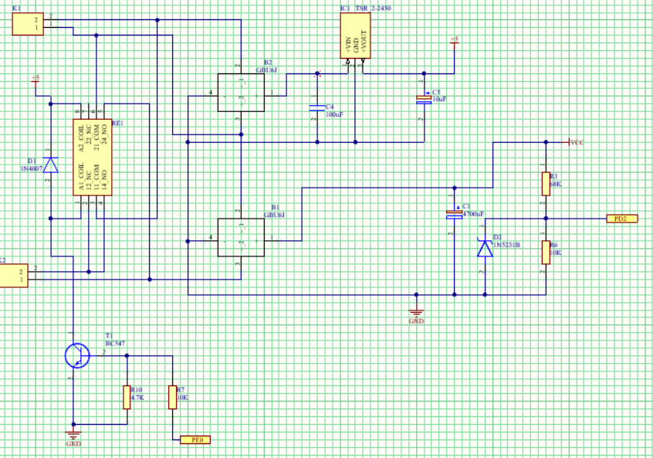
Schematic Designs
15
Notes:
Like a told you in step 5 that i used 5 schemetic sheets that is to keep each part that have a different function separated to keep the overview

Slide 16
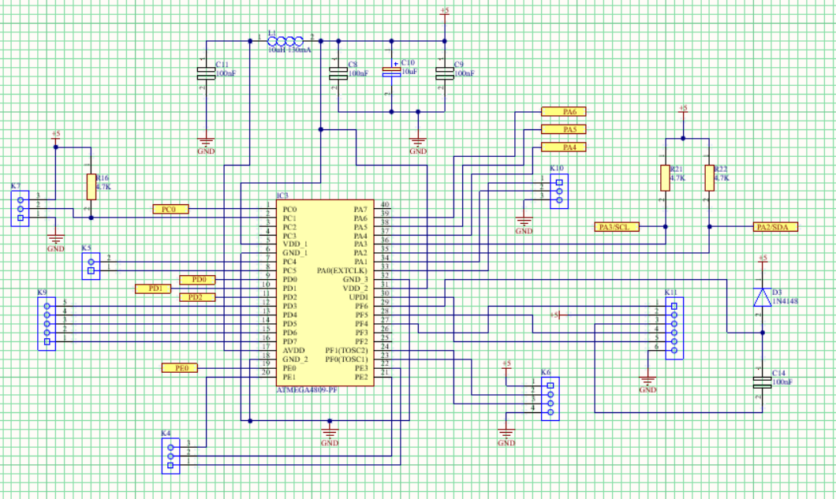
Schematic Designs
16
Notes:
Like a told you in step 5 that i used 5 schemetic sheets that is to keep each part that have a different function separated to keep the overview

Slide 17
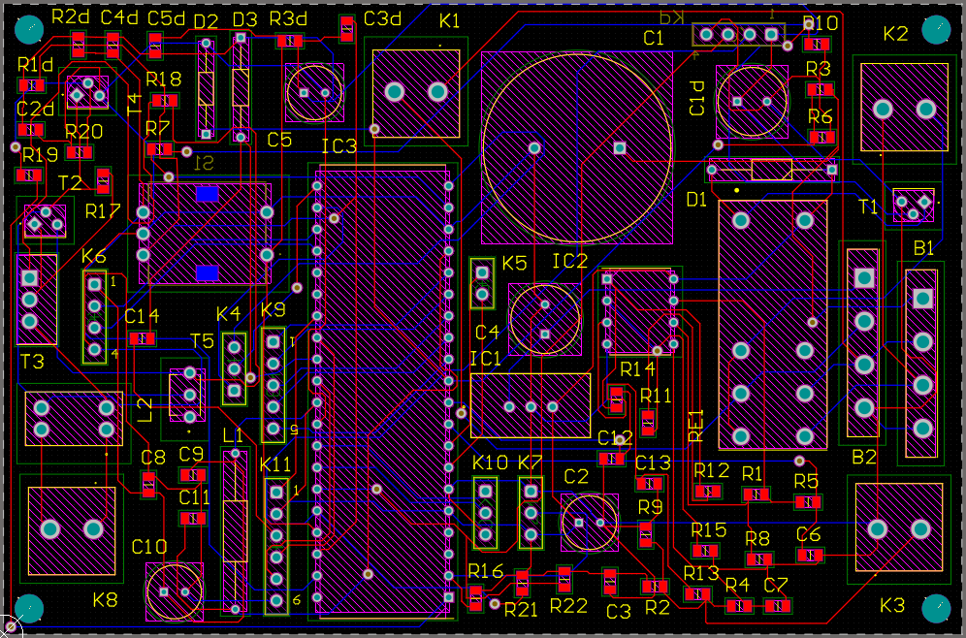
PCB Designs
17
Notes:
I designed it so that it was compact and doesn’t have a special shape (cost more )

Slide 18
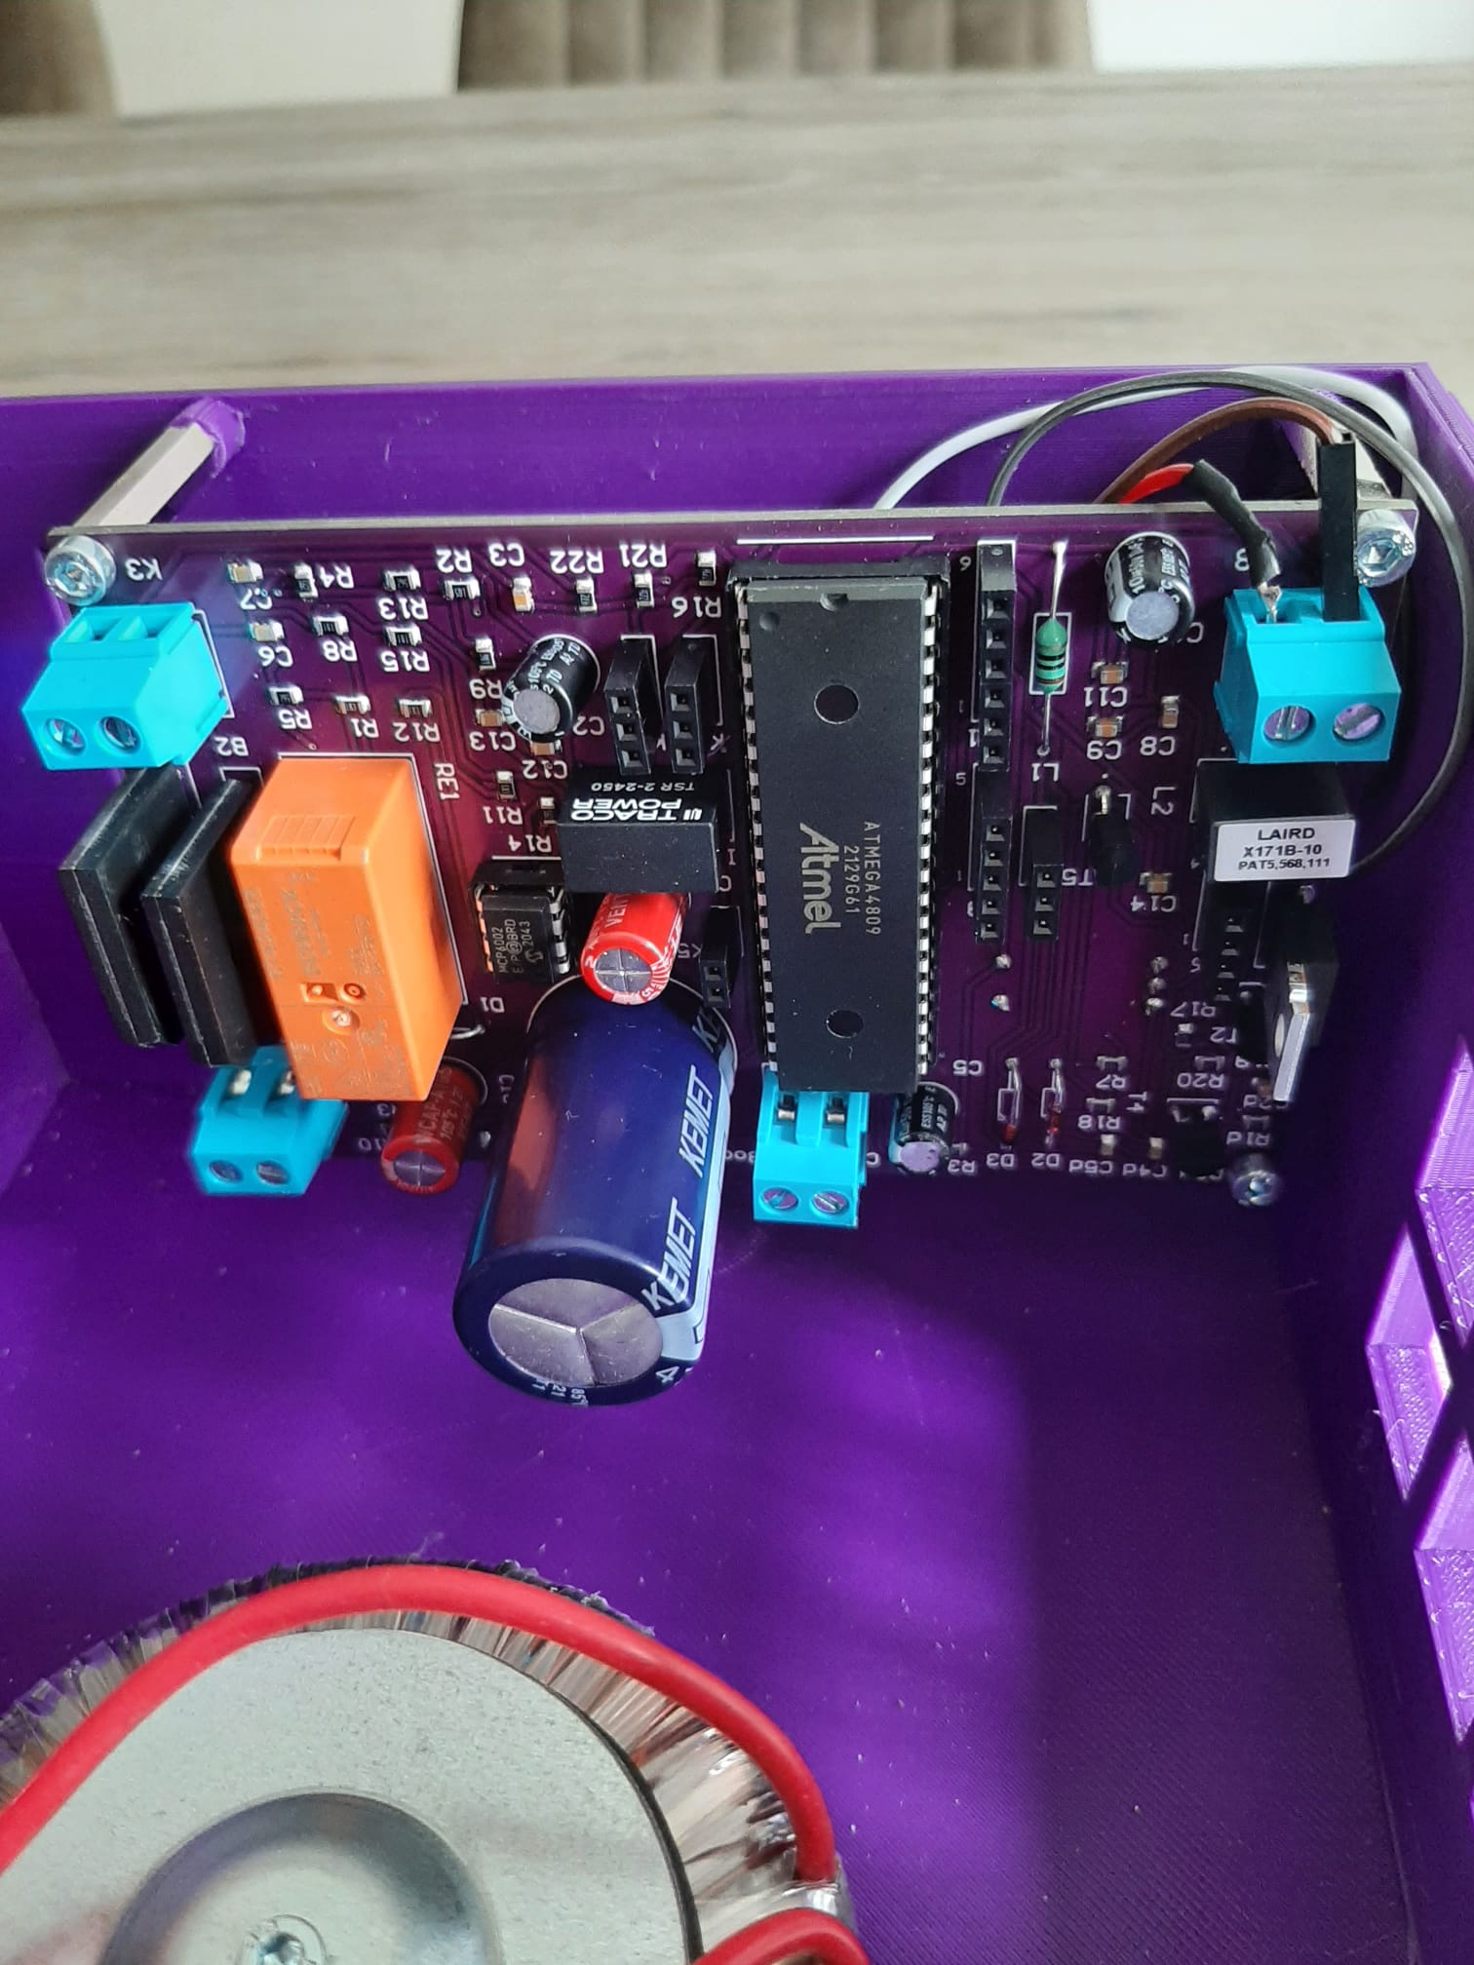
Physical circuit board
18
Notes:
Like a touched briefly in step 10 we start with the SMD and after that the soldered the part needed to test out the power supply,
Onces that was a succes the other components where soldered,
Was not that easy because of the large capasitor that was already mounted for the power supply,

Slide 19
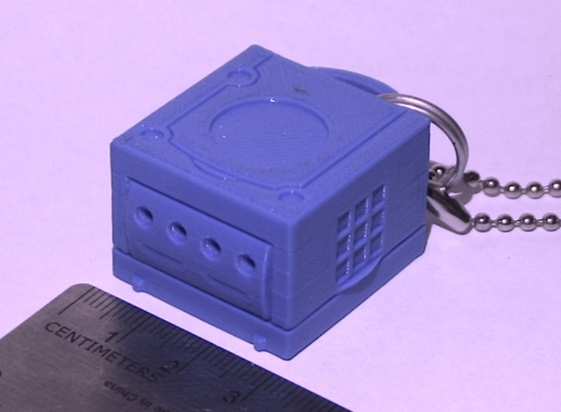
3D design
Nintendo Gamecube
Thingiverse
19
Notes:
The 3D design is from the beginning chosen to be the Nintendo Gamecube, it was and still is one of my childhood memory’s and despite its lesses popularity due to
the first Xbox en PS2 launcing around the same period it is still nostalgic gameconsole,
First i stared to draw it from scratch but after a while and thought of thingiverse an open-source site where I found this design

Slide 20
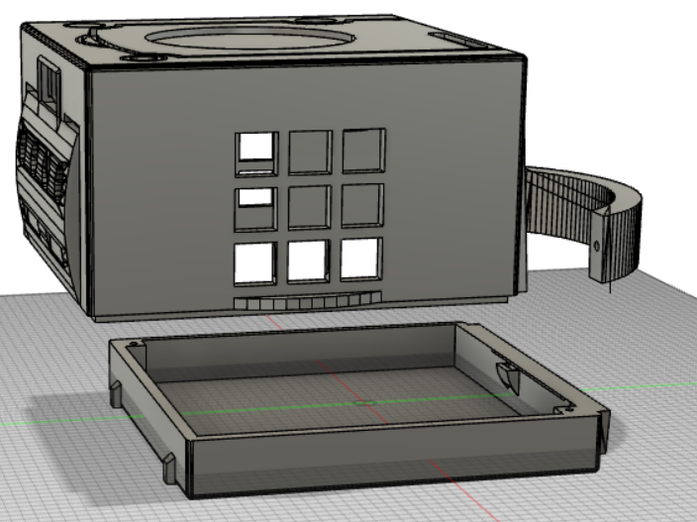
3D design
20
Notes:
In total 8 body’s (main part, handle, base plate, 2 vents pieces, button in ganger form, disk ganger (decoratief) and tim boghe design (decoratief)

Slide 21
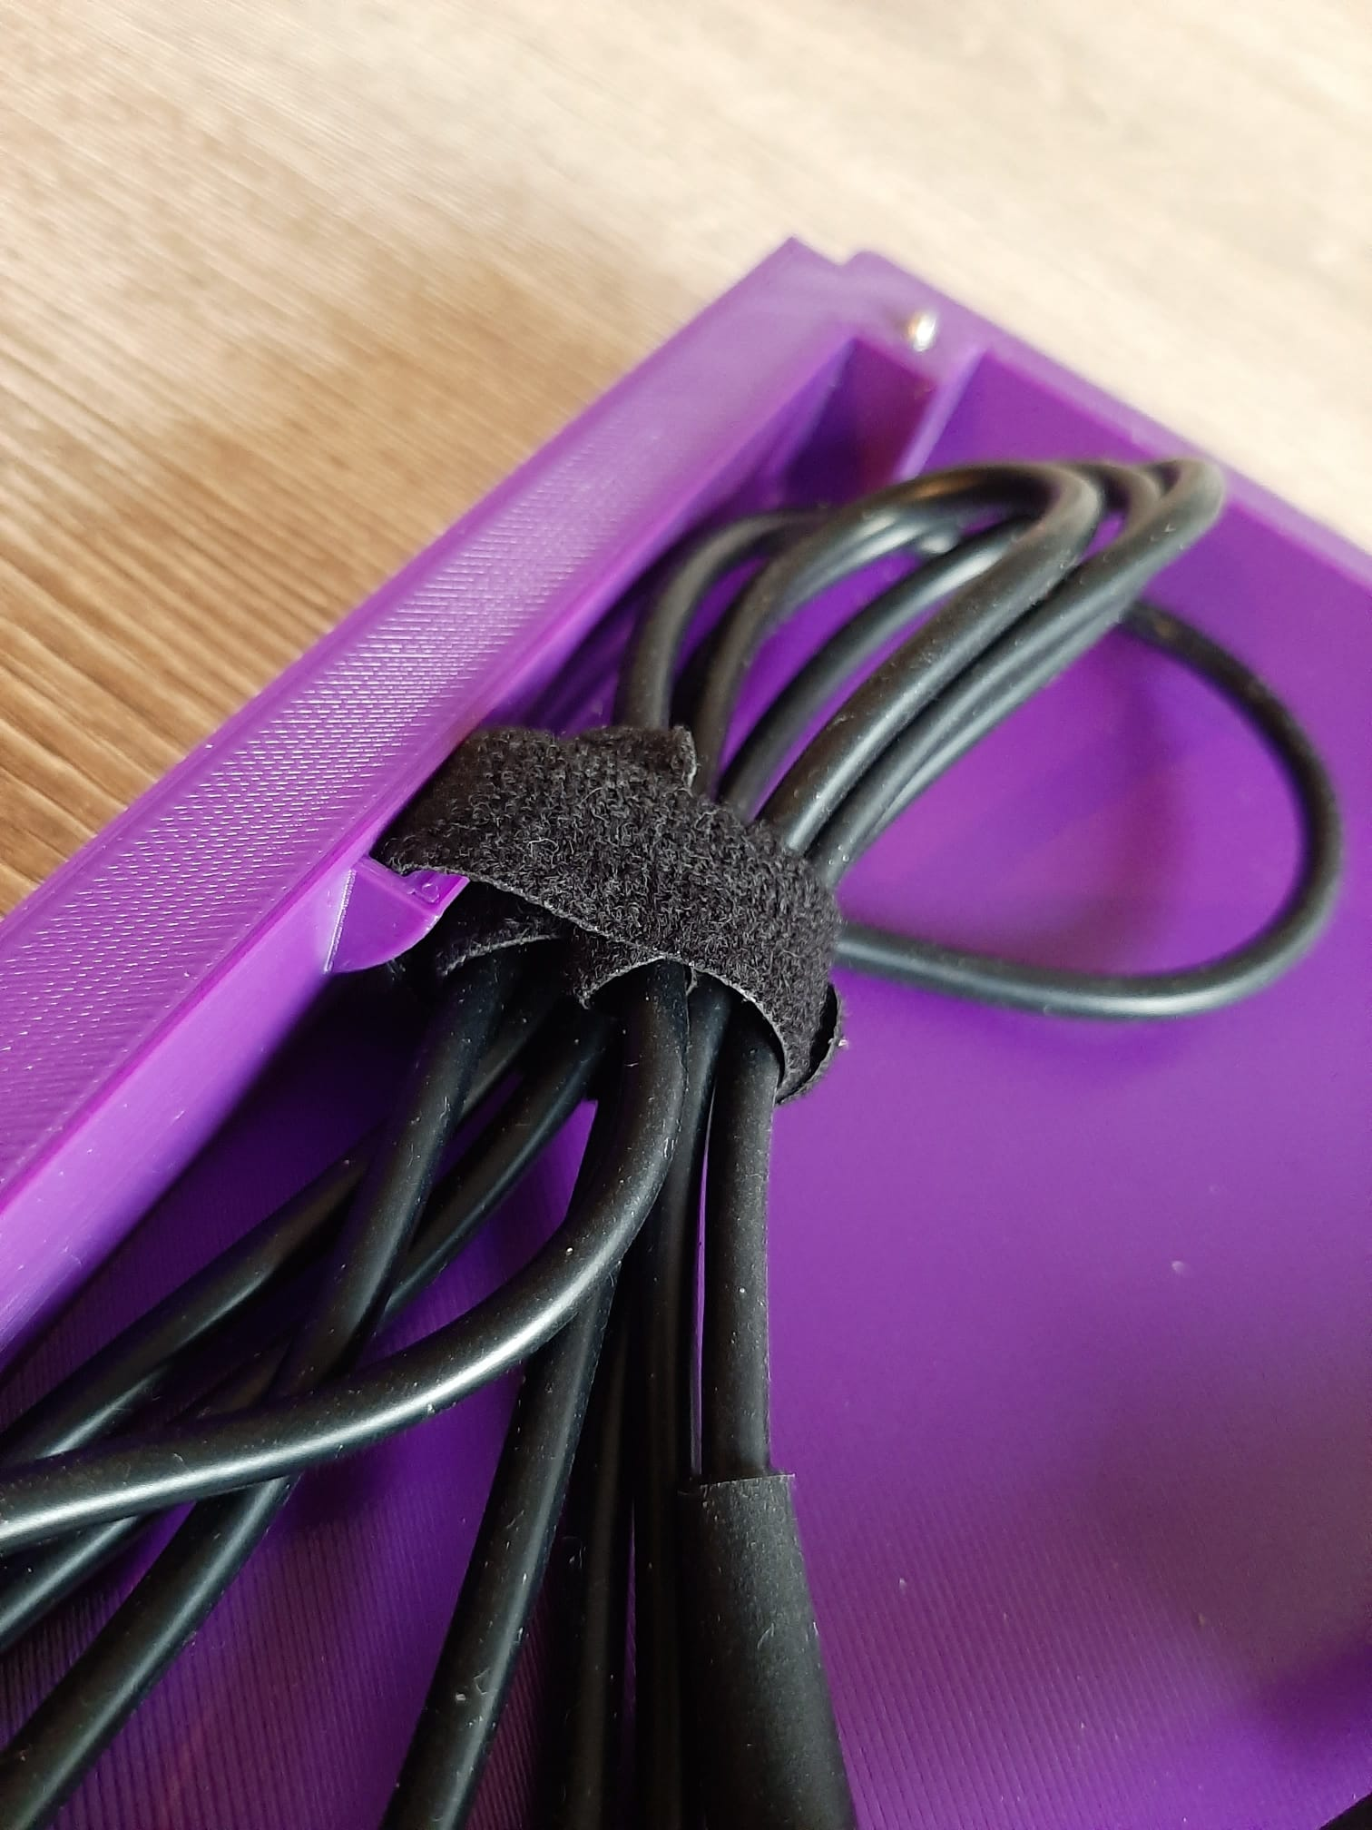
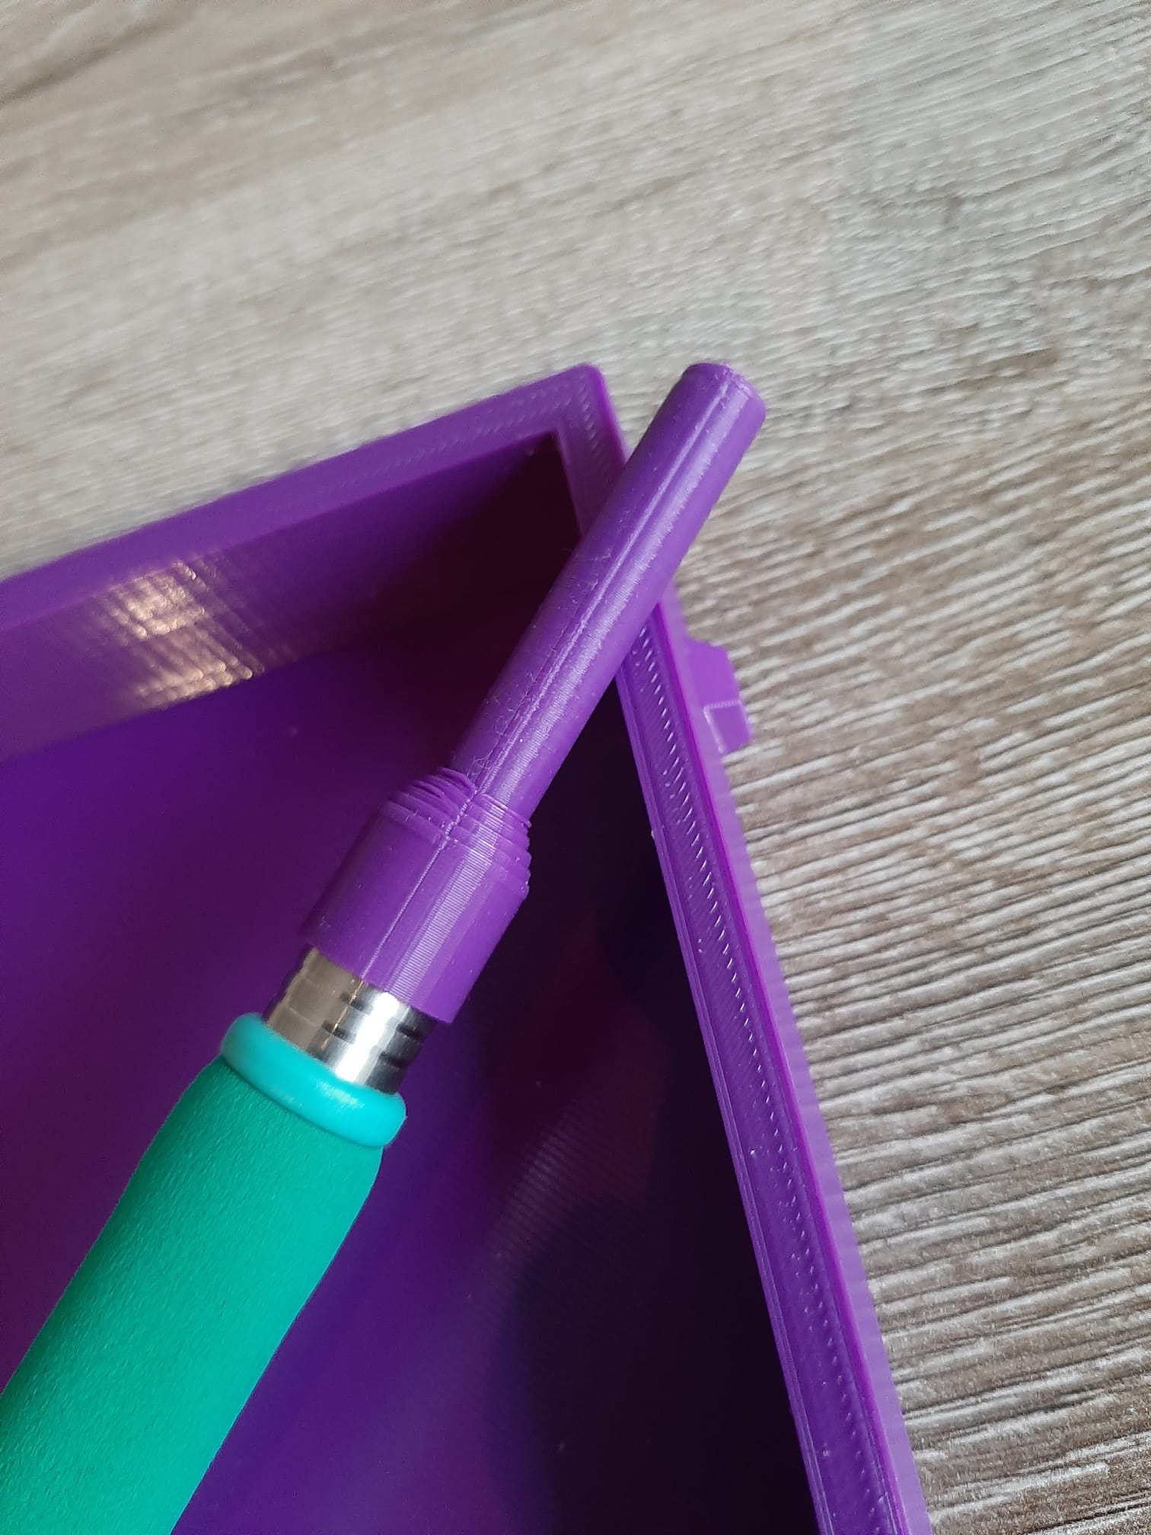
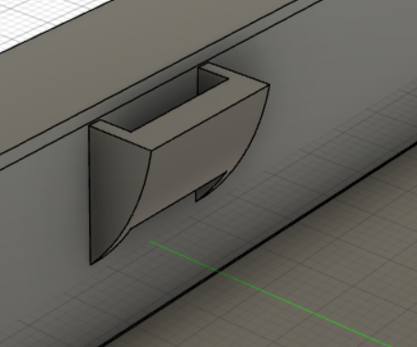
3D design (extra features)
locking point soldering iron
Soldering iron tip protection cap
Notes:
The 3D design is from the beginning chosen to be the Nintendo Gamecube, it was and still is one of my childhood memory’s and despite its lesses popularity due to
the first Xbox en PS2 launcing around the same period it is still nostalgic gameconsole,
First i stared to draw it from scratch but after a while and thought of thingiverse an open-source site where I found this design

Slide 22
A few problems/adjustments
Mountinghole encorder SMD?
Cost -> free samples
Notes:
1: mouser ECAD model not correct, solution making it external with wires and mouting in in case
2: cost is a bit higher that what i wanted to spent -> more free samples from wurth next time
3: aliexpres display not that cheap with fast shipping and some problems with the programming of it
4: to close with front pannel of the case -> solution working with spacers

Slide 23
Conclusion
Great learning and experience moment
How to improve
Notes:
1: we learned a lot by doing this project not only the how to make a PCB or designing a case but also more about what al the components do in a real application
2: what the do in a different way in the future for all sections of this project PCB design, making something in autocad fusion, what components to use

Slide 24
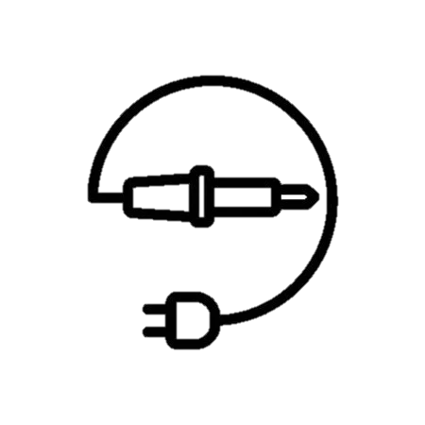

Thank you for you attention.
Are there any questions?

